Slide 1


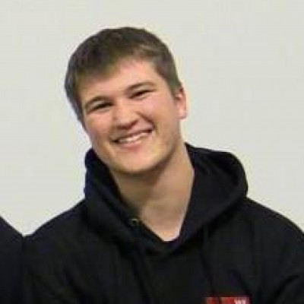
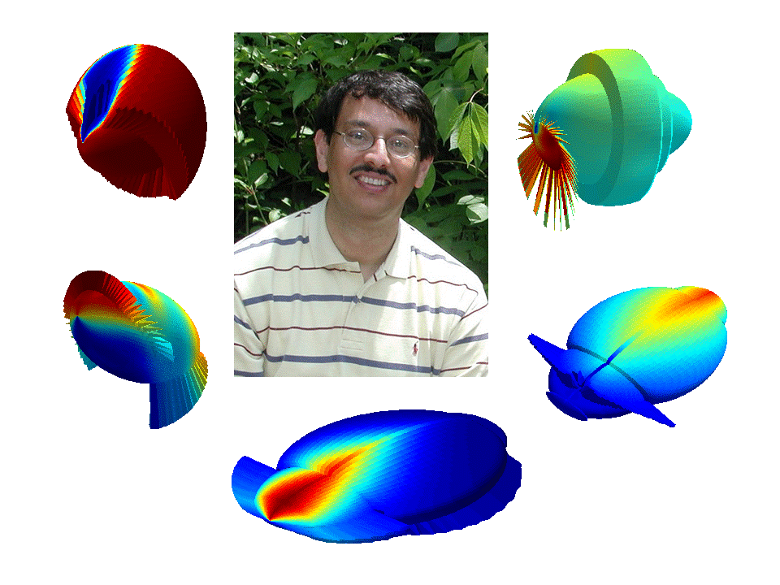
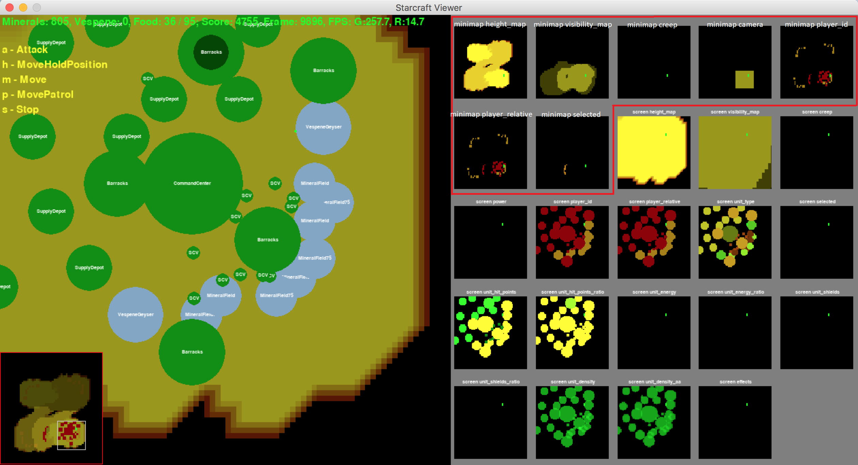



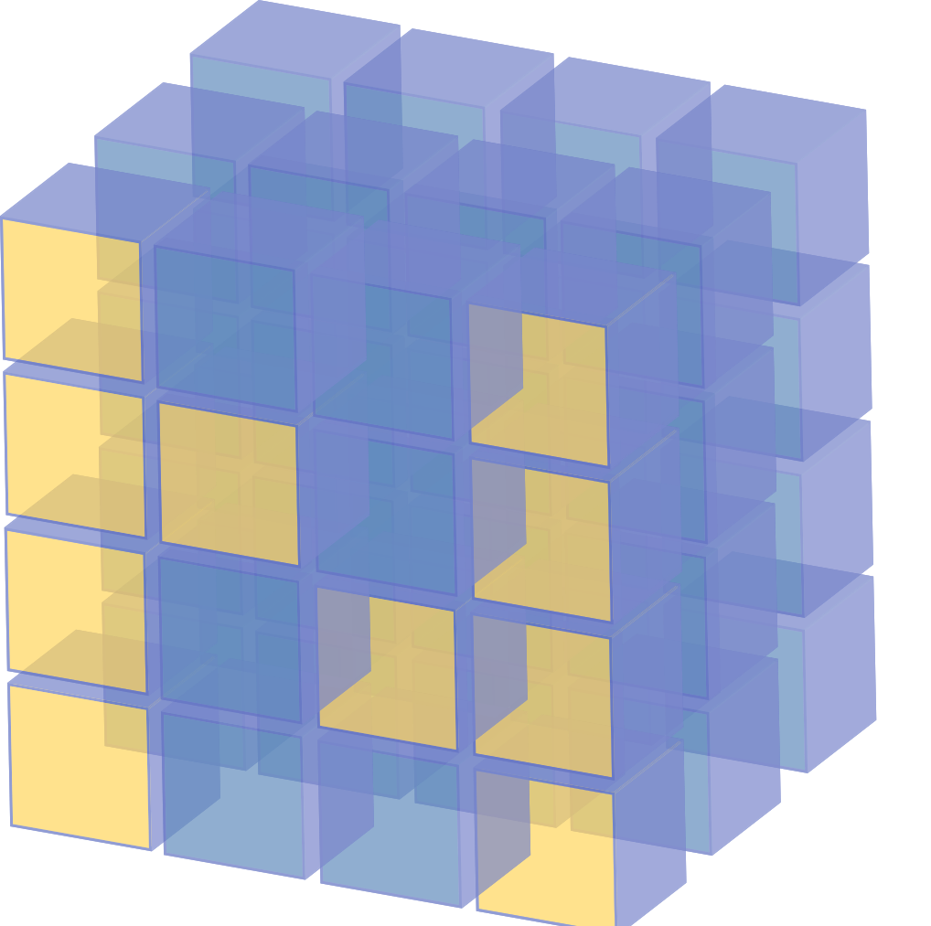
Background
There have been many recent advances in game-playing AIs, such as the Dota 2 AI and AlphaGo. With this project, we aim to explore the use of conventional and cutting edge machine learning techniques to create a self-learning Starcraft 2 AI agent that is capable of playing against Blizzard’s built-in AI.
Design and Input
Kyle Arens
Ryan Benner
Jon Deibel
Dr. Ali Minai
Advisor
Milestone Achievements
10/31 – Develop a scripted AI using capable of defeating Medium AI opponents.
12/05 – Implemented a simple Q-learned model capable of occasionally winning against Very Easy AI.
1/13 – Update to a deep-learned model with better success than Q-learned.
2/5 – Update reward algorithm to use player score. No noticeable change.
Scope & Decisions
With 3 distinct factions to play as and an action space of ~10⁸ possibilities, we limited our project in the following ways:
Only train as Terran.
Only train on a small 64x64 map.
Train via reinforcement only against Blizzard AI.
The Blizzard AI’s race will change each iteration.
Restrict our action space to simple actions, such as:
Build SCV
Build Marine
Build Barracks
Build Supply Depot
Prevent training bot from moving camera.
Feed the AI the current screen region and 7 distinct minimap layers.
Utilize a Q-learning table to handle multi-dimensional tensors.
The seven regions boxed in red above serve as a high-level overview of the first layer of inputs that we feed into our machine learning model. These seven layers are:
Height Map – observe terrain differences, impacting vision.
Visibility Map – observe current and past exploration.
Creep – shows where Zerg has spread “creep”. Race-specific.
Camera Selection – shows where the camera is currently located.
Player Id – shows units based on owning-player’s ID.
Player Relative Team – shows units relative to their respective teams.
Selected – shows the currently selected unit.
Future Work
Expand action space to the full possibility of Terran’s actions.
Train against multiple maps.
Train AI to change camera location.
Utilize Pro-player replay data.
Expand input space to include all mini-map layers.
Train AI to play as Protoss and Zerg.

